Slide 1
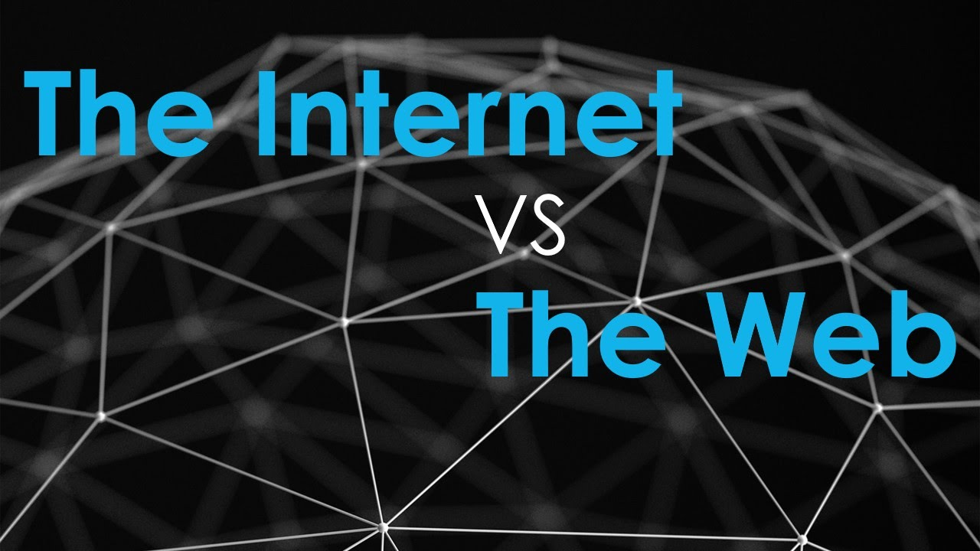

Slide 2
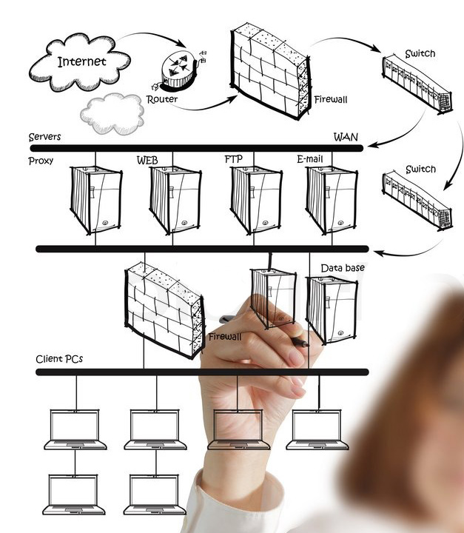
Internet
Internet can be defined as the worldwide network where machines like computers, servers, and smart devices are connected together for communication and data exchange purposes.
Internet is the network of networks interconnecting computing devices located throughout the world. These networks use some communication protocols to link the network devices with each other.

Slide 3

World Wide Web
The World Wide Web (WWW) is a network of online content that is formatted in HTML and accessed via HTTP.
The term refers to all the interlinked HTML pages that can be accessed over the Internet.
The World Wide Web was originally designed in 1991 by Tim Berners-Lee while he was a contractor at CERN.
The World Wide Web is most often referred to simply as "the Web."

Slide 4
Internet vs Web
The internet is an enormous network of billions of connected computers and other hardware devices. Each device can connect with any other device as long as they're both connected to the internet with valid IP addresses.
Web, on the other hand, consists of all the web pages you can view when you access the internet.
The internet — not the web — is also used for email, instant messages, newsgroups, and file transfers.
In other words, the web is just a large portion of the internet, but it isn't all of it.

Slide 5

Domain Name vs IP Address
A domain name is your website name. A domain name is the address where Internet users can access your website. A domain name is used for finding and identifying computers on the Internet.
Computers use IP addresses, which are a series of number. However, it is difficult for humans to remember strings of numbers. Because of this, domain names were developed and used to identify entities on the Internet rather than using IP addresses.

Slide 6
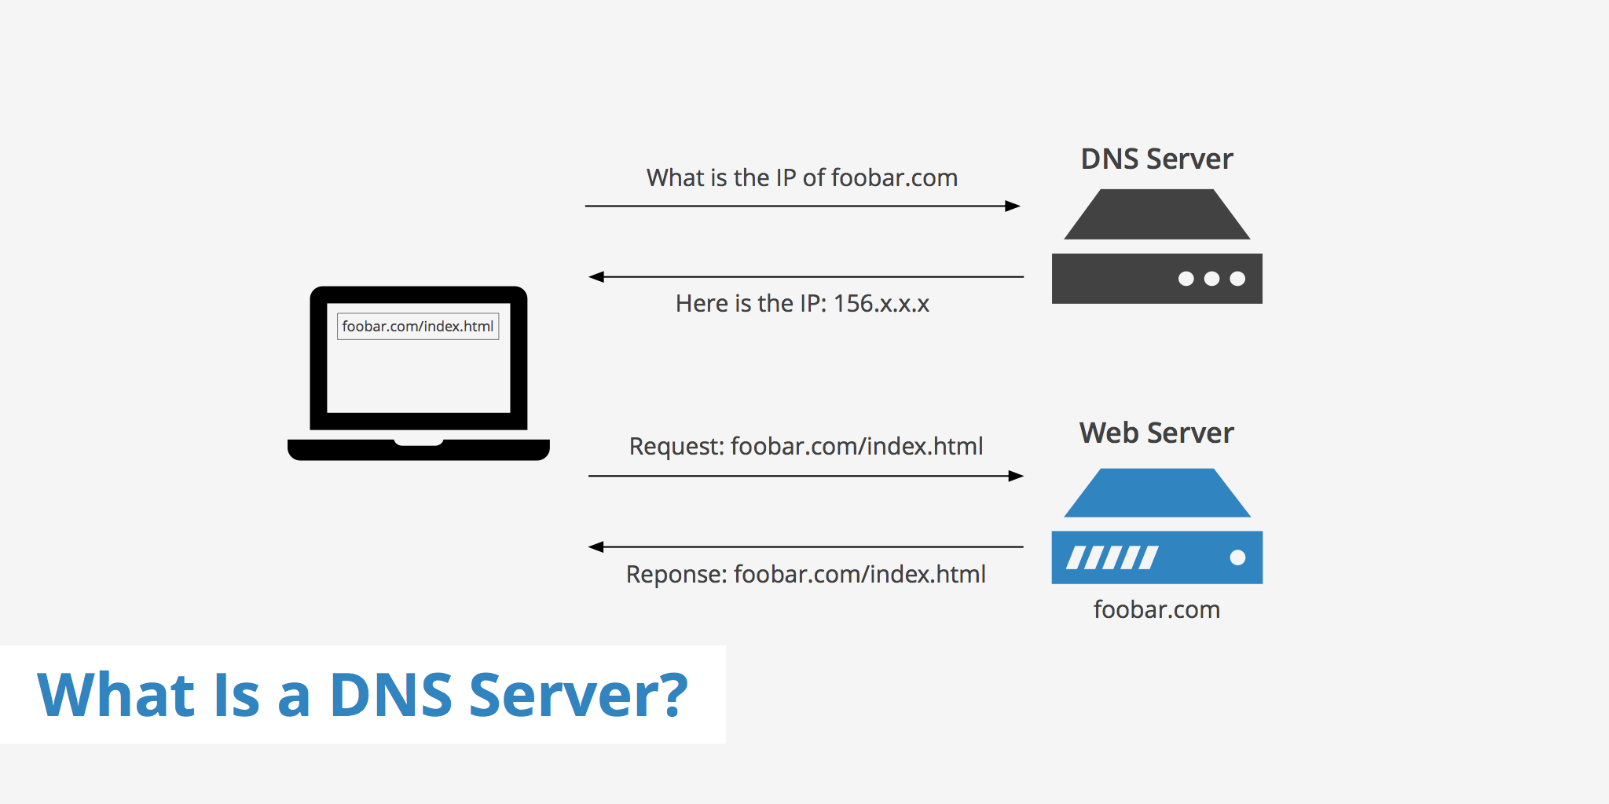
Domain Name Server

Slide 7


Slide 8
Inter Service Provider
An Internet Service Provider (ISP) is the industry term for the company that is able to provide you with access to the Internet, typically from a computer.
An ISP is your gateway to the Internet and everything else you can do online. The second your connection is activated and set up, you'll be able to send emails, go shopping, do research and more.

Slide 9
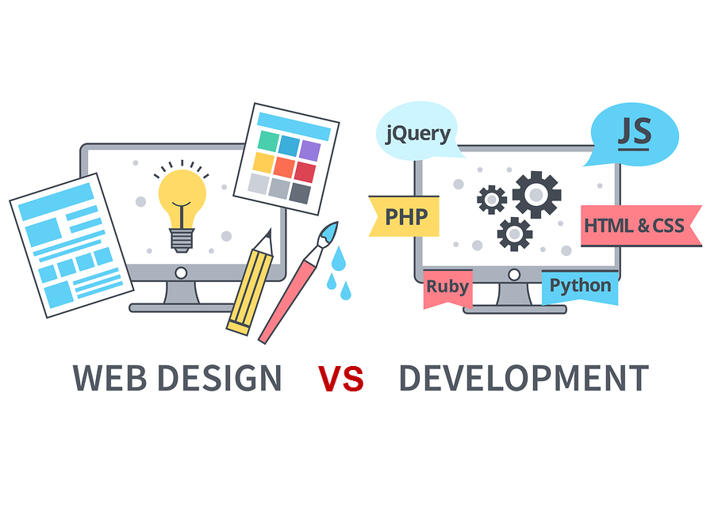

Slide 10
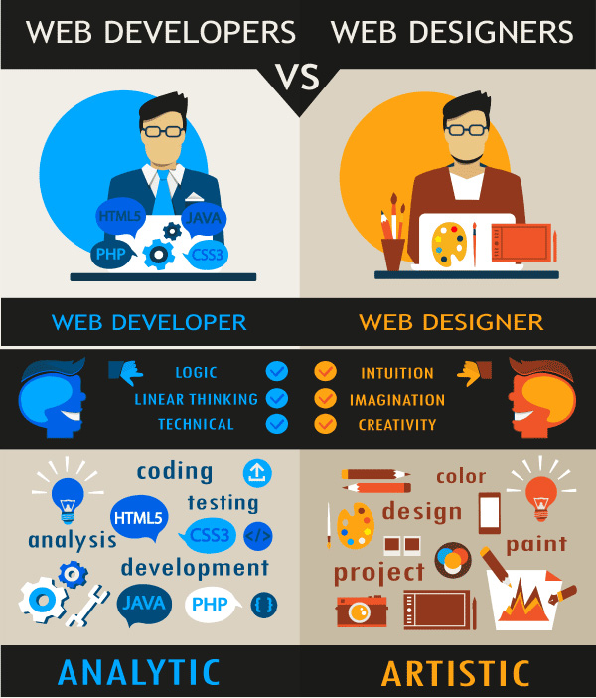

Slide 11
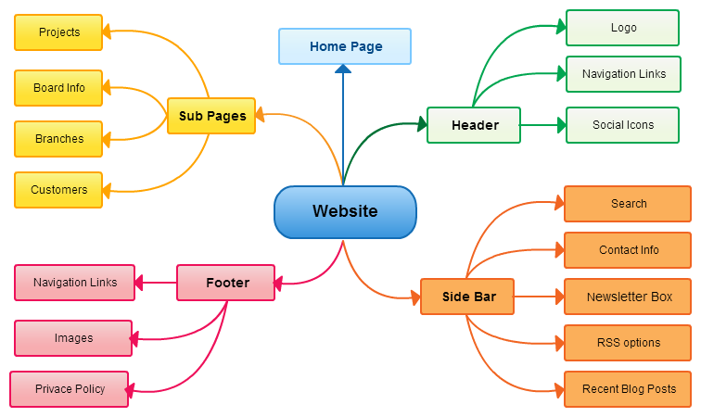
Website MindMap
Structure
Content
Layout

Slide 12

HTML

Slide 13

Importance of HTML
HTML is easy to use and understand
All browsers support HTML
HTML is free
Most development tools support HTML
HTML is most search engine friendly
In most cases, HTML is all you need
Everything is eventually translated to HTML on internet.
HTML is the "mother tongue" of your browser.
HTML was invented in 1990 by a scientist called Tim Berners-Lee.
Notes:
http://www.vtech-seo.com/web-design-articles/advantages-of-html.html

Slide 14
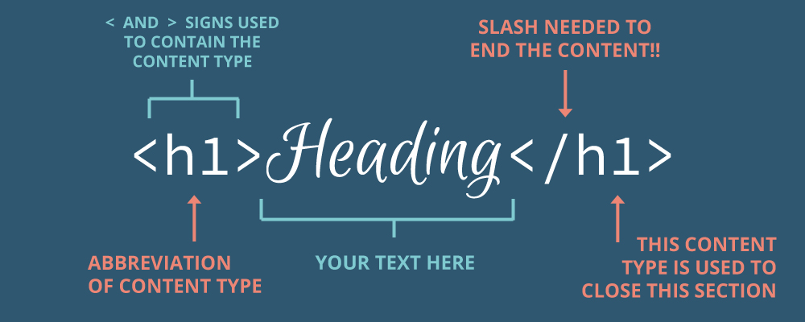
HTML: What is it?
HTML stands for Hyper Text Markup Language
An HTML file is a text file containing small markup tags <HTML> </HMTL>
The markup tags tell the Web browser how to display the page
An HTML file can be created using a simple text editor or a WYSIWYG editor
Notes:
That is the language that makes it possible for various computers to communicate with each other. These computers may be on different networks, in different countries, different platforms, different operating systems, desktops, mobiles, tablets, et cetera.HTML is the common tongue. It's what makes all of this possible.
HTML stands for Hypertext Markup Language. Hypertext refers to the ability to create links to other pages and other web resources. Markup means that it's used for creating pages of formatted text along with images and other resources embedded in the page.
The ability to create hyperlinks is a fundamental capability in HTML.

Slide 15
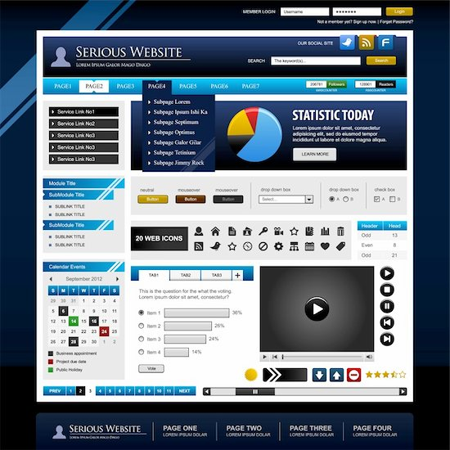
Anatomy of a Website
Your Content + HTML: Structure + CSS: Presentation = Your Website
A website is a way to present your content to the world, using HTML and CSS to present that content & make it look good

Slide 16
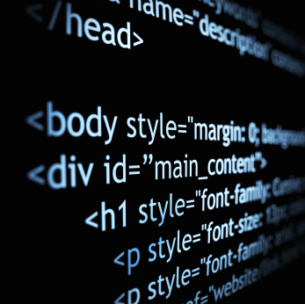
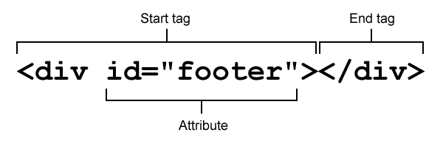
HTML TAG SYNTAX
An HTML element starts with a start tag / opening tag
An HTML element ends with an end tag / closing tag
The element content is everything between the start and the end tag
Some HTML elements have empty content
Empty elements are closed in the start tag
Most HTML elements can have attributes

Slide 17
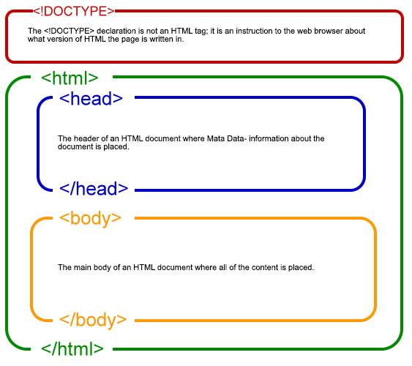
HTML Page Structure
<!DOCTYPE html>
<html>
<head> <title>
Title of the document
</title>
<link rel=“stylesheet” type=“text/css” href=“main.css” /> </head>
<body> <h1>
HTML Document
</h1>
<p>
This is a sample HTML document to understand basic structure.
</p>
</body> </html>
Notes:
The doctype isn't an actual tag, but it needs to be at start at every HTML page to tell browser which version of HTML you're using (HTML5, in example below).
The html tag is always the first tag in the page.
<!DOCTYPE html> <html> </html>

Slide 18
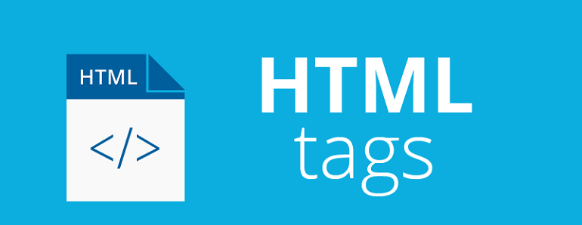
Tag | Description
<html> | Defines an HTML document
<title> | Defines a title for the document
<body> | Defines the document's body
<h1> to <h6> | Defines HTML headings
<p> | Defines a paragraph
<br> | Inserts a single line break
<a> | Defines a hyperlink
<!--...--> | Defines a comment
<strong> | Defines important text
<img> | Defines an image

Slide 19
Tag | Description
<form> | Defines an HTML form for user input
<input> | Defines an input control
<textarea> | Defines a multiline input control (text area)
<button> | Defines a clickable button
<select> | Defines a drop-down list
<optgroup> | Defines a group of related options in a drop-down list
<option> | Defines an option in a drop-down list
<label> | Defines a label for an <input> element
<fieldset> | Groups related elements in a form

Slide 20
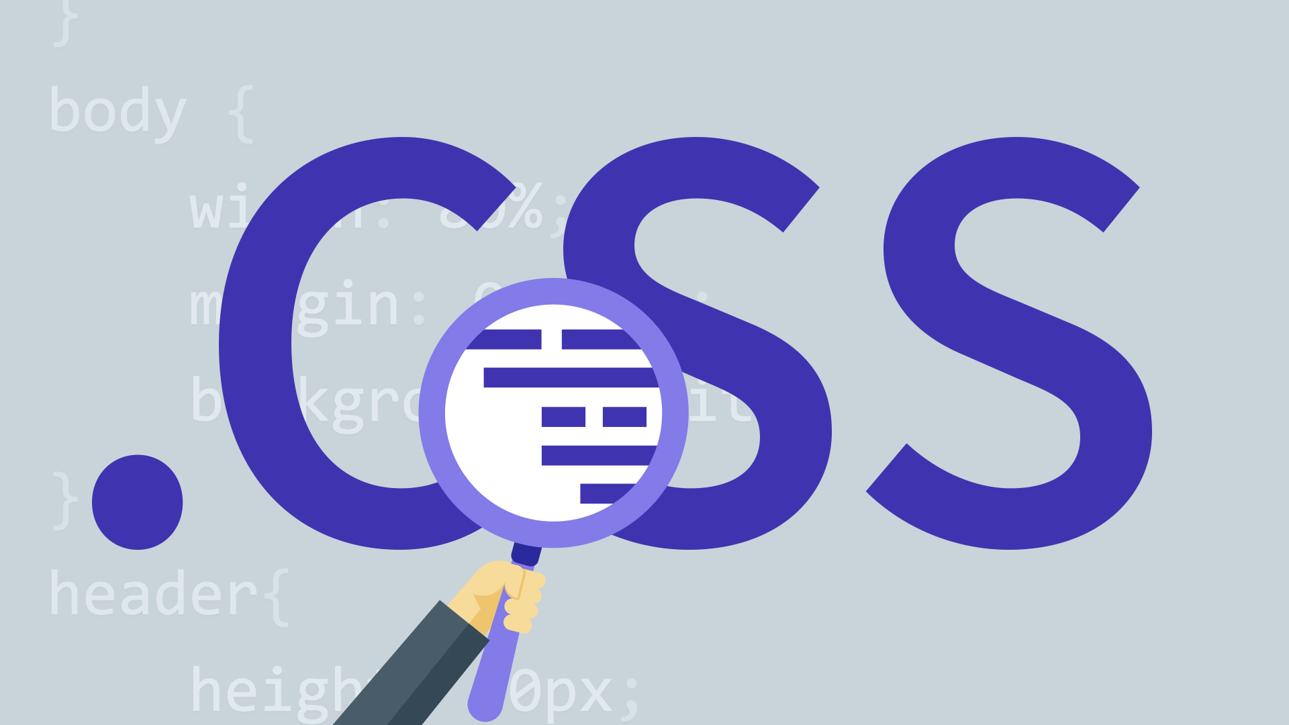

Slide 21
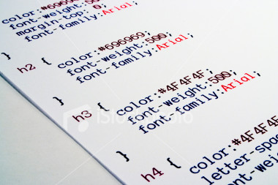
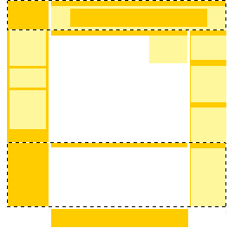
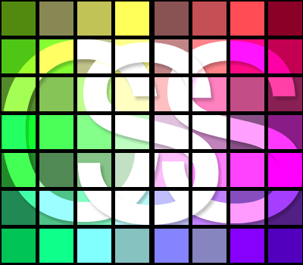
What is CSS ?
CSS stands for Cascading Style Sheets
Styles define how to display HTML elements
Styles were added to HTML 4.0 to solve a problem
External Style Sheets can save a lot of work
External Style Sheets are stored in CSS files

Slide 22
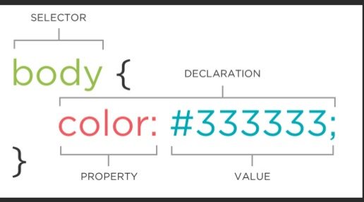
CSS Syntax
Selector
all elements of a specific type, e.g. the second level headers h2
to elements specified by attribute, in particular:
id: is used to specify a style for a single, unique element.
Class : is used to specify a style for a group of elements. Unlike the id selector, the class selector is most often used on several elements..
Declaration Block
A declaration block consists of a list of declarations in braces. Each declaration itself consists of a property, a colon (:), and a value. If there are multiple declarations in a block, a semi-colon (;) must be inserted to separate each declaration.

Slide 23
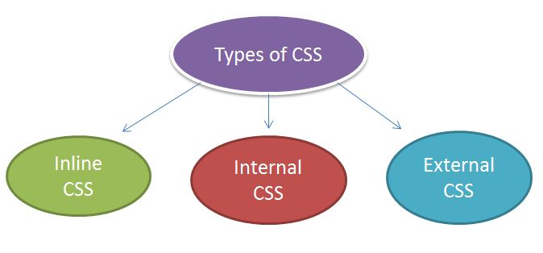
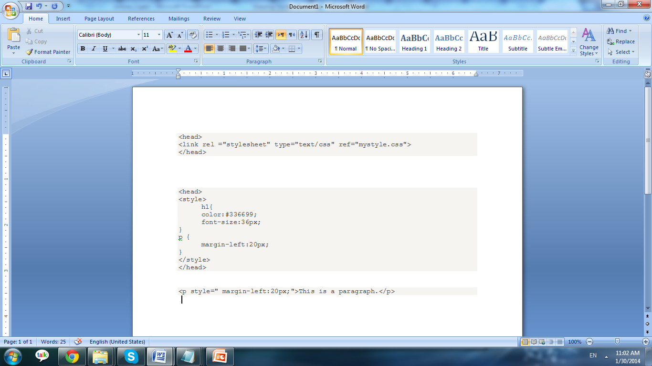
3 Ways to Insert CSS
External style sheet
Internal style sheet
Inline style

Slide 24

Site Builders

Slide 25
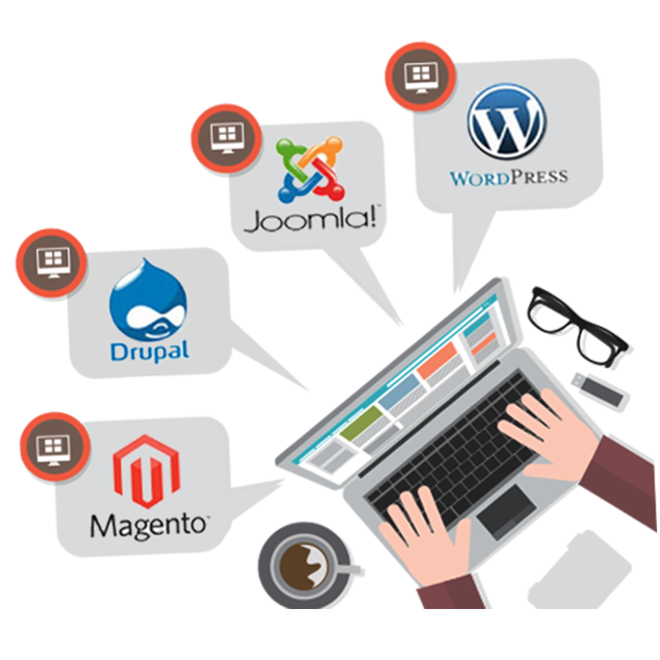
Content Management Systems
A content management system (CMS) is a software application or set of related programs that are used to create and manage digital content.
Better Content Management System
Consistency in Look and Feel of Website
Complete control over the Website
Updatable Anytime with Simple Customizations

Slide 26
Easy web development
Wordpress.com
Site123.com

Slide 27
Assignment
Design a website in Site123.com (10 Points)
5 linked webpages
Appropriate content on pages

Slide 28

Thank you
Notes:
https://www.youtube.com/watch?v=cNN_tTXABUA

